Slide 1

        Overview

Slide 2
SUMMARY
Introduction
  What is Jmeter ?
  Why ?
Preparing tests
  Step 1 Proxy server
  Step 2 Organization
  Step 3 Genericity
  Step 4 Assertions
Running tests
  Non GUI mode
  Distributed testing
  Analyzing Test

Slide 3
Introduction
Definition :
  JMeter is an Apache Jakarta project that can be used as a load testing tool for analyzing and measuring the performance of a variety of services, with a focus on web applications.
Why ? :
  JMeter can be used as a unit test tool for JDBC database connection, FTP, LDAP, WebServices,J MS, HTTP and generic TCP connections. JMeter can also be configured as a monitor, although this is typically considered an ad-hoc solution in lieu of advanced monitoring solutions.

Slide 4
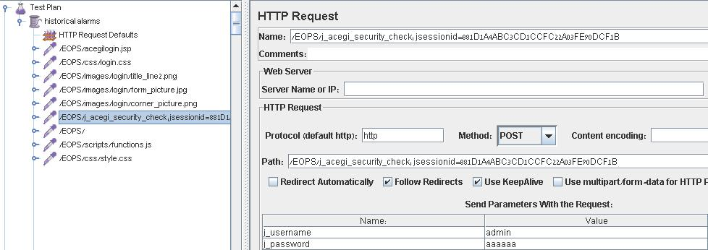
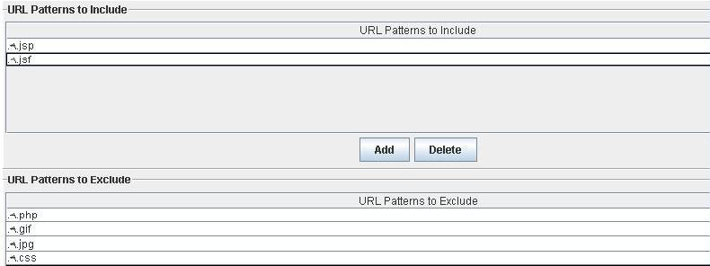
Proxy Server
Role
  Record Http requests run by users.
  Stick to the exact http request a lambda user .
  Record only what is meaningful.
  To be organized.
Warning
  Doesn’t record https.

Slide 5
Organization
Thread groups
Loop controllers
Determine
  How many users, will concurrently run the tests
  How long between 2 launch of the test
  How many times the tests will be run
Determine in a thread group
  How long between 2 launch of the same sampler
  How many times the set of tests will be run.

Slide 6
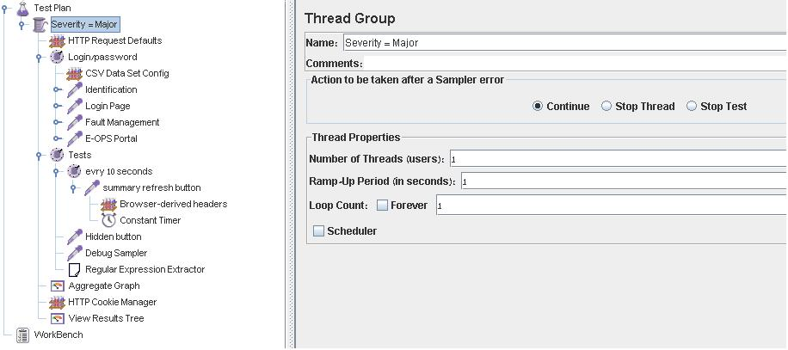
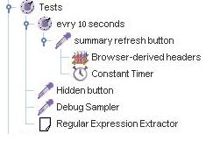
Organization
Thread groups
Loop controllers

Slide 7
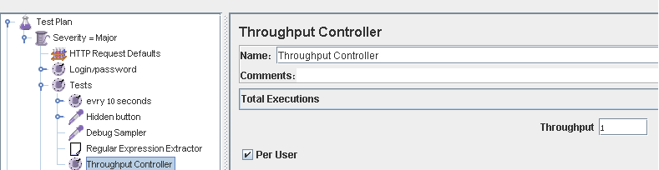
Organization
Throughput Controller
Make variable pause during the test run to simulate better a client behavior.
Because the thread group doesn’t take in count the server, can take several seconds before responding.

Slide 8
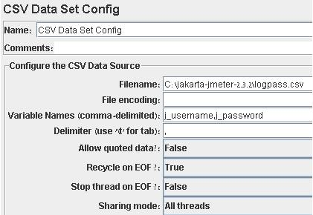
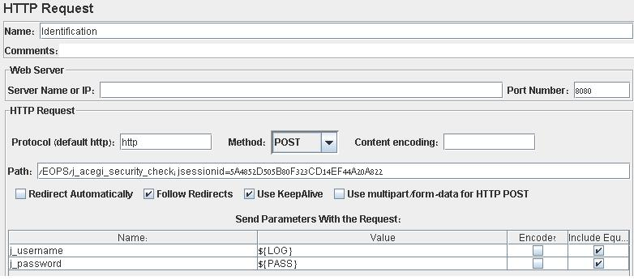
Genericity
Variabilisation :
  In order not to modify a test to run it on different machines
  Example : user and password changing from a shelf to an other

Slide 9
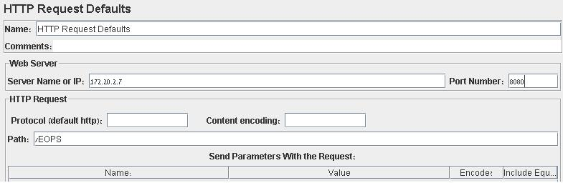
Genericity
Http default Request
  Allows you to put a default ip port and path for all the Http Request contained in the scope
  Gives you an easy way to run your test from a device to an other one just by changing the default adress.

Slide 10
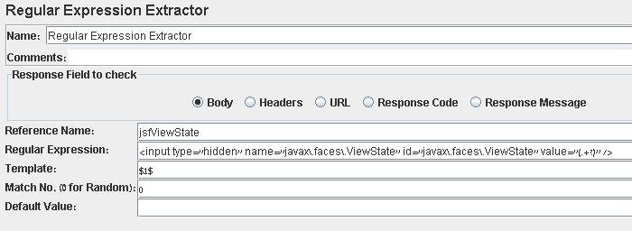
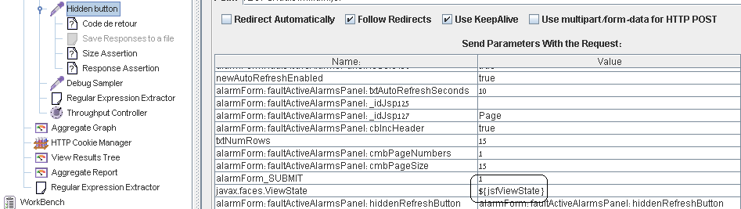
Genericity
Regular Expression extractor
  If the data has to be used several times along the test
    Like a sessionId for instance.

Slide 11
Assertions
Response assertion
  To match a pattern in the response code
    The response code for instance.
Xpath assertion
  Using the DOM of the response to check if an element appear.
    A research result for instance.
Size assertion
  To know if the size of the response received match with the size expected
    To verify if the file received is the good one.

Slide 12
Running tests
Non Gui Mode
  Why?
    The stress due to test and display is too high when running distributed tests.
  How ?
    By running command line
      Example : jmeter -n -t my_test.jmx -l log.jtl -H my.proxy.server -P 8000

Slide 13
Distributed testing
Why ?
  To simulate stressed environment with a lot of clients.
How ?
  Edit “remote_hosts=127.0.0.1” in jmeter.properties
  Start jmeter_server.bat on the host machines
  Run jmeter.bat

Slide 14
Analyzing Test
Aggregated graph
Result tree
Gives all the statistics concerning the tests
May be recorded in a specified file for further treatment (data mining)
Gives in a tree form, all the samplers results, the requests, and the sampler data.
May also be recorded in a specified file for further treatment

Slide 15
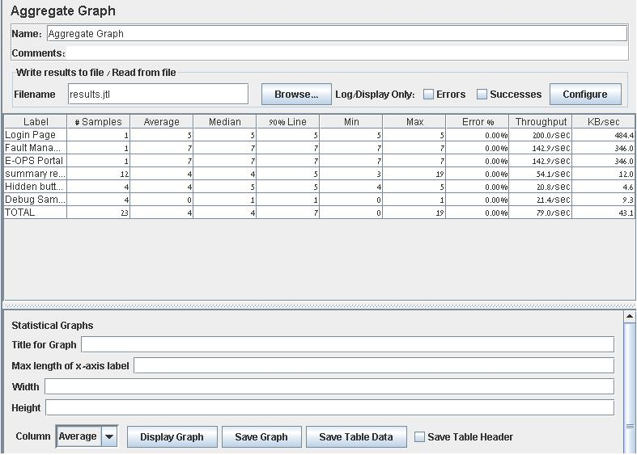
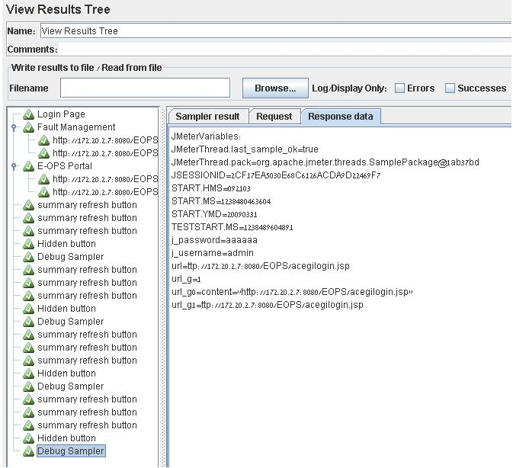
Analyzing Test
Aggregated graph
Result tree

